Slide 1
Predicting the Presence of Cancer in Breast Cancer Cells
Gustavo “David” Reyes, Kenny Rodriguez, Bryan Rojas, and MacKenzie Wright
Notes:
MacKenzie

Slide 2
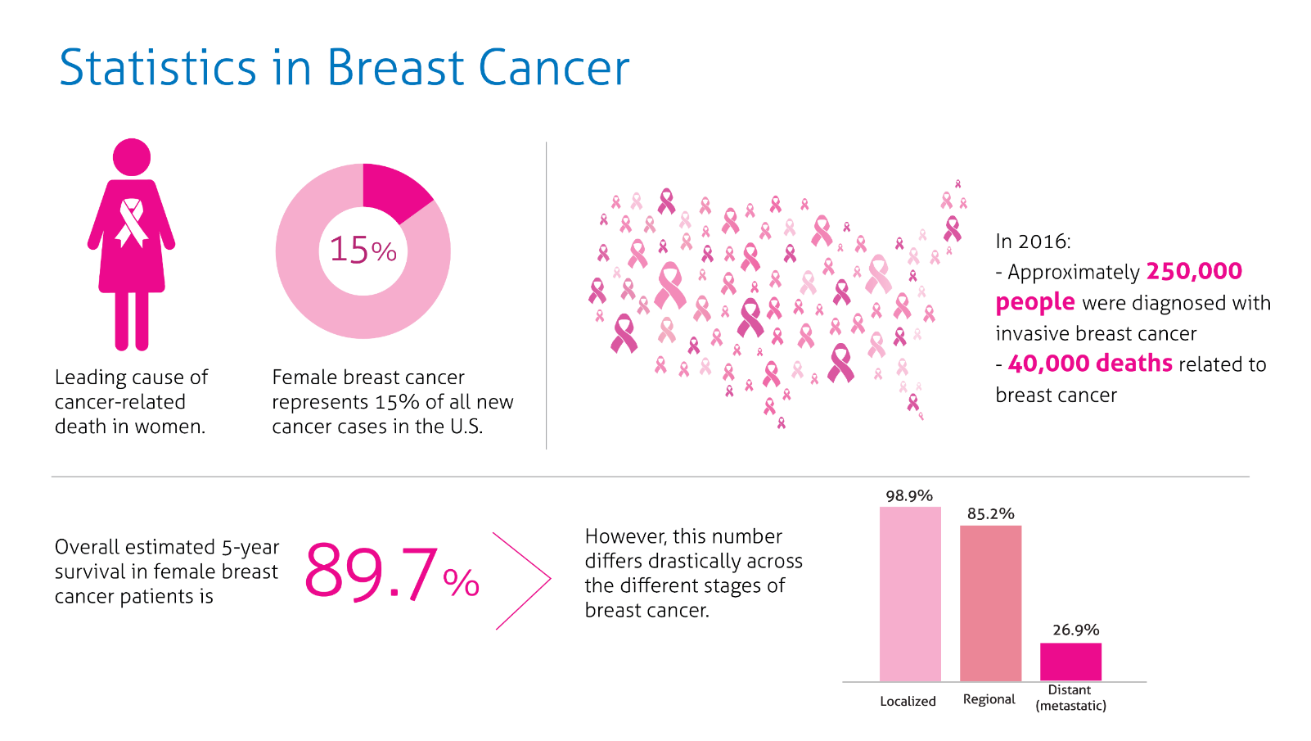
The Use of Machine Learning to Predict the Presence of Breast Cancer
Why did we pick this topic?
Breast cancer is the one of the most common cancers among women. The American Cancer Society estimates about 287,850 new cases of invasive breast cancer will be diagnosed in the United States during the year 2022.
https://magellanhealthinsights.com/2018/10/09/october-is-national-breast-cancer-awareness-month/
Breast cancer statistics: How common is breast cancer? American Cancer Society. (n.d.). Retrieved May 20, 2022, from https://www.cancer.org/cancer/breast-cancer/about/how-common-is-breast-cancer.html
Notes:
MacKenzie
Breast cancer is the most common type of cancer in women following skin cancer.
About 30% or 1 in 3 women with new cases of cancer will be diagnosed with breast cancer. In the year 2022, 287,850 new cases of invasive breast cancer will be diagnosed in the United States.
The reason why breast cancer is deadly is the relative closeness to the lymph nodes found in the armpits. If the cancer cells spread to the lymph nodes, they can easily spread throughout the body using the lymphatic and vascular system.

Slide 3
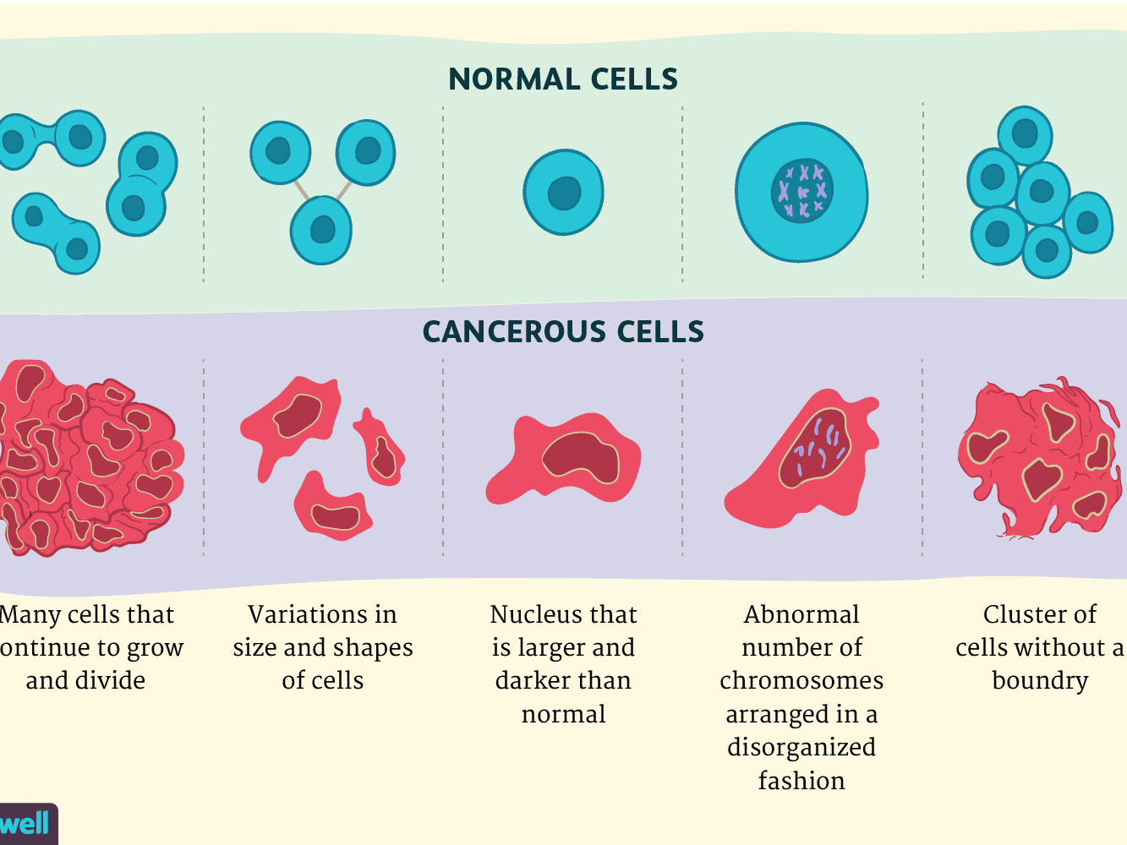
let’s have a quick biology lesson…
Before we begin,
Before moving forward, it is important to cover a few details about tumor cells and how they’re distinguishable from normal healthy cells.
Tumors, benign or malignant, are abnormal cells who’ve undergone several changes in order to achieve the ability to grow outside of a normal cells restraints.
In other words, one mutated cell does not equal cancer, but rather a list of mutations in multiple cell generations is what causes tumorous tissue.
https://www.verywellhealth.com/cancer-cells-vs-normal-cells-2248794
Notes:
MacKenzie
Before we get into the analysis part, let’s discuss what would actually be considered cancer.
A person can have a tumor, but it does not necessarily mean they have cancer; the tumor can either be benign or malignant. Benign meaning it is not cancerous and malignant meaning it is cancerous.
A tumor are normal cells who have gone through several changes in order to achieve the ability to grow outside its normal restraints.
Simply put, one mutated cell does not mean mean it is cancer; there are other factors involved in the cells mutation over several generations that would lead to the cell to grow into cancerous tissue.

Slide 4
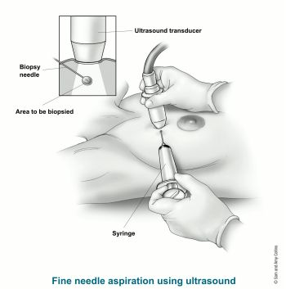
Our Data
The measures used to create our dataset were created through the use of FNA (fine needle aspiration) samples of individuals with suspected tumors.
The measures we used are as follows:
Radius, Texture, Perimeter, Area, Smoothness, Compactness, Concavity, Concave Points, Symmetry, and Fractal Dimension
https://www.cancer.org/cancer/breast-cancer/screening-tests-and-early-detection/breast-biopsy/fine-needle-aspiration-biopsy-of-the-breast.html
Notes:
MacKenzie
Our dataset consists of measurements taken of cells using FNA, or fine needle aspiration, from people with suspected tumors.
The image to the right shows how each sample would have been taken from each patient using this method.
The ultrasound would locate the tumor within the breast tissue and then be used to guide the needle to the desired location to acquire the sample.
The measurements that were focused on were Radius, Texture, Perimeter, Area, Smoothness, Compactness, Concavity, Concave Points, Symmetry, and Fractal Dimension
Radius = mean of distances from center to points on the perimeter
Texture = standard deviation of gray-scale values
Perimeter = the distance around the edge of a shape of the cell.
Area = area based on the cell’s perimeter
Smoothness = local variation in radius lengths
Compactness = perimeter^2 / area - 1.0
Concavity = severity of concave portions of the contour
concave points = number of concave portions of the contour
Symmetry = cell symmetry based on mean radius
fractal dimension = ( a measure of the space-filling capacity of a pattern that tells how a fractal scales differently from the space it is embedded in.) “coastline approximation” - 1
These values were computed by the using the images from each sample. We inherited the data after it was manipulated to reflect the mean of each measure, the standard error, and the mean of the largest or “worst” of these features. This process was surely to create a standardization of the values since each measure would have a different standard of measurement.

Slide 5
The Goal of our Analysis
Our goal is to apply the power of machine learning models to identify the likelihood that a tumor could either be benign or malignant. To accomplish this, we first need to answer the following questions:
Which features have the greatest likelihood of predicting malignancy?
How should the data be structured in order to test?
What machine learning model would best predict breast cancer malignancy?
Notes:
Bryan
Read the slide

Slide 6
Recount of Technologies, Tools, Languages, and Algorithms
Machine Learning Model: Google Colab - Python, Pandas, PySpark, and Matplotlib/Seaborn
For ease of sharing amongst all four members, we used Google Colab to write and build our Machine Learning Model. This would also allow us to easily upload the DataBase through the cloud easier with Amazon Web Services (AWS).
DataBase: AWS - RDS and S3 & Postgres
As stated previously, AWS was used to easily add the DataBase to our notebook. With AWS, we connected to the Database locally with Postgres to create the tables we used for this model. After the tables were created, we loaded them back to AWS, which can then be added to our notebook on Google Colab
Interactive Visualization: Tableau
For the dashboard we created, we used Tableau to create a drop down menu of the different graphs we created in order to allow the user to have a better grasp of how different features affect the diagnosis of the patient’s sample.
Notes:
Bryan
Machine Learning Model:
For our machine learning model, we used Google Colab to write all our code so we can share it amongst all the people in our group since it uses the Cloud to save all our work and it allows us to load packages with ease.
Languages
To build our machine learning model, we used the language Python. Within Python, we used Pandas, PySpark, and Matplotlib.
Pandas allows us to load a CSV file with all the data we are trying to analyze directly into our notebook. From there we can create tables and dataframes with our data to conduct our analysis.
PySpark allows us to load our data from Amazon Web Services into our notebook over the cloud. Similarly to Pandas, we were able to create schemas to visualize the data in table formatting.
Matplotlib and Seaborn are programs that allowed us to create visualizations of our analysis so we could further comprehend what the data is telling us. The visual graphs and charts used in our presentation were created using these programs.
DataBase:
Read from slide
Interactive Visualization:
Read from slide

Slide 7
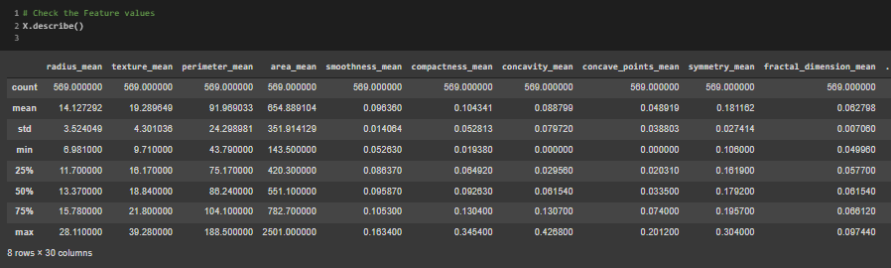
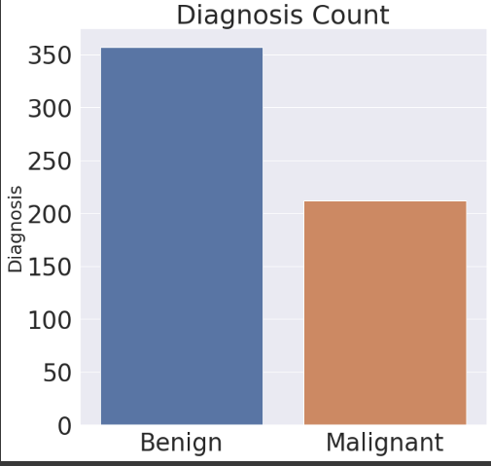
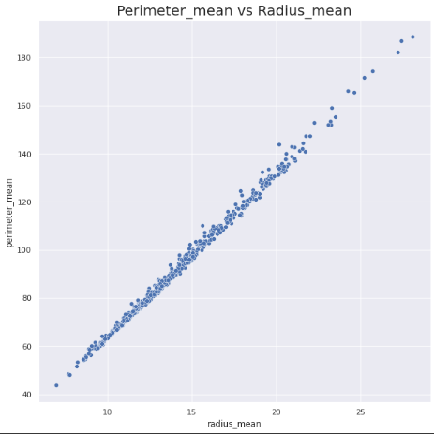
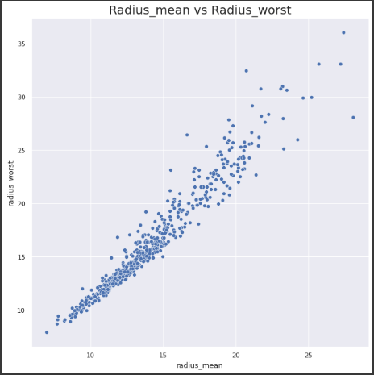
Exploratory of our Data
Our initial exploratory analysis provided insight to identify where to focus our model and provide a scaffolding for our work moving forward.
We began to identify patterns in our dataset. Correlations between features allowed us to identify a few columns to test with a linear regression model and test it.
The results were promising, so the model was evolved into a logistical regression model that could test all the features in our dataset.
Benign tumors vs
Malignant tumors
Total = 569
Benign = 357
Malig. = 212
Perimeter mean vs Radius mean
Radius mean vs Radius worst
Notes:
Bryan
Our initial exploratory of the data allowed us to find correlation between certain features within our dataset.
From there we decided to run a linear regression model on those features and then we decided to run a logistic regression on all the features in our dataset.

Slide 8
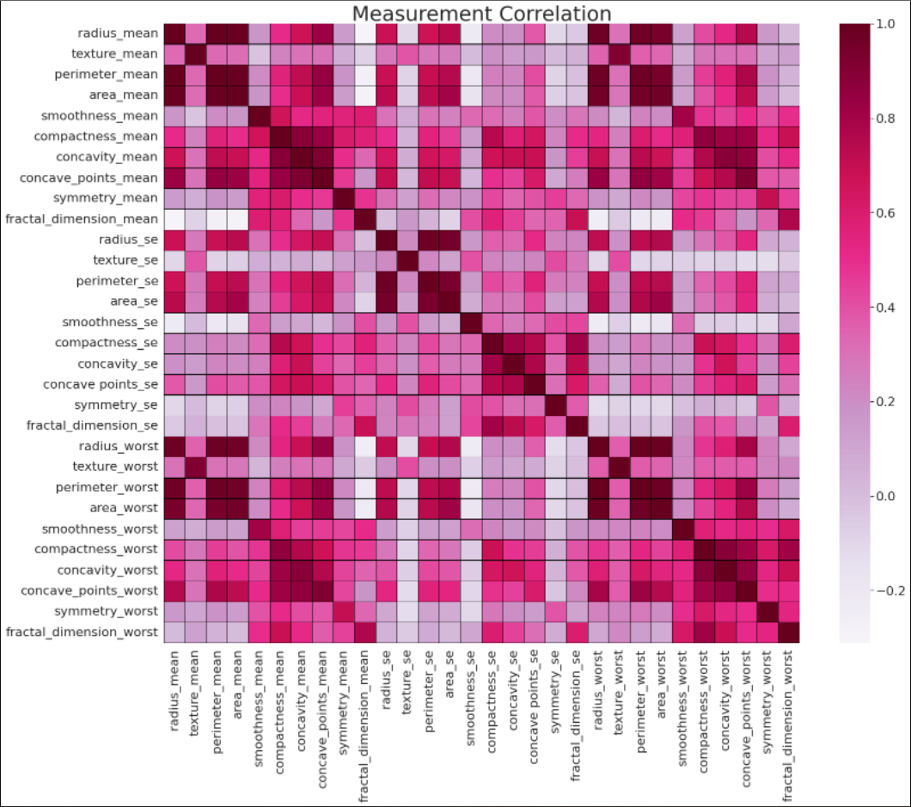
Exploratory of our Data
A benign tumor has distinct, smooth, regular borders. A malignant tumor has irregular borders and grows faster than a benign tumor.
Using Seaborn and Matplotlib, we were able to infer that feature to focus on using a heatmap.
The results draw our attention to the hot spots were we can eliminate features that are vs themselves, since those would clearly have a high correlation.
Here’s a list of the tables we will build using what we found from the heatmap:
Perimeter mean vs Radius mean
Perimeter mean vs Radius worst
Perimeter mean vs Area mean
Perimeter mean vs Area worst
Radius mean vs Area worst
Area mean vs Radius mean
All values along the cyan line are negligible since all these values are the result of each feature against itself.
Notes:
Kenny
The figure to the right provides the correlation of all our features against themselves by shading does of high correlation closer to the color Purple and those with less correlation white or light red.
From looking at the heat map, we created tables based off the features that have the features that correlate with each other the most

Slide 9
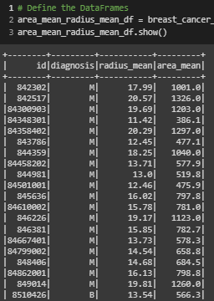
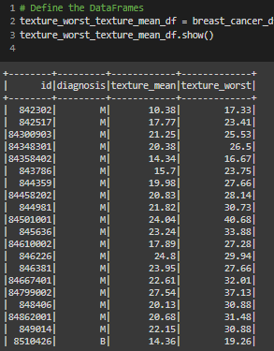
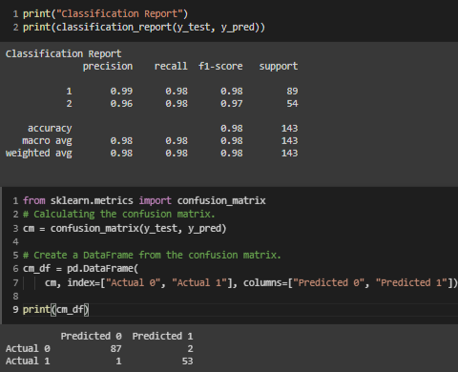
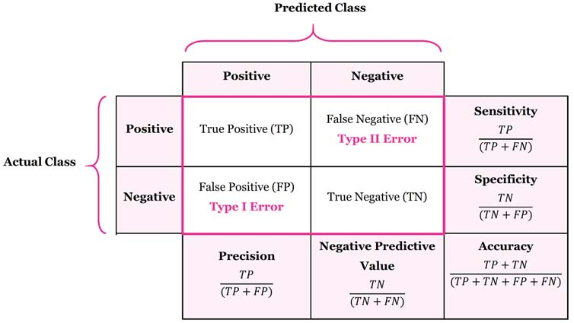
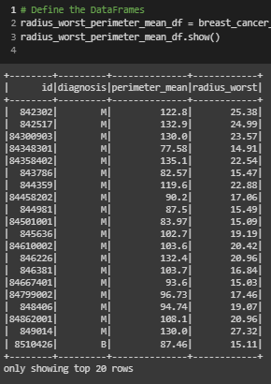
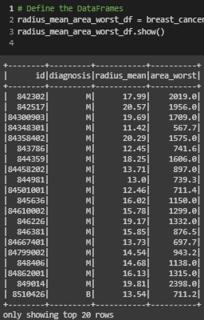
Exploratory of our Data
The values we’ve measured have presented incredibly accurate results. Further evaluation of other features may need to performed to assess the sensitivity of the machine learning model.
Classification Report
Confusion Matrix
With the above results being so high in each field, our goal was to further test our model using some of the techniques covered during our machine learning module to assess the sensitivity, accuracy, and precision.
Also, the number of testing samples appears too small. We hope to address this by trying oversampling to see resilient our model is.
Notes:
Kenny
Within the confusion matrix, the positive prediction, labeled 0, is malignant tumor and negative is a benign tumor, labeled 1.
After running the classification report and the confusion matrix, we can see that the model was extremely accurate across all the fields. From there, we ran our accuracy scores.

Slide 10
Interactive Dashboard
Interactive Tableau Dashboard
Notes:
Kenny

Slide 11
What we learned from our Machine Learning Model…
We ran both a Linear and Logistic Regression Models to determine which was better for predicting cancer based off the list of features provided.
For the Linear Regression, we achieved an 84.27% accuracy score which is considered acceptable.
For Logistic Regression, we received a 97.09% accuracy score meaning that a Logistic Regression is a very reliable model to use to predict whether someone has cancer based off the list of features we have provided the model.
Notes:
Kenny
Read slide
Unsure why our accuracy score for the logistic regression accuracy score was so high, we put our heads back together to try and determine what exactly in our data was leading our model to be so accurate.

Slide 12
Further Exploratory
We went back to our dataframe and dropped all the features that involved size.
Those features include:
radius_mean, radius_worst, area_mean, area_worst, perimeter_mean, perimeter_worst
This look the original 20 features we started with and brought it down to 14 total.
Notes:
David
Thinking about it simply, we know that cancer cells are often characterized by its size so we decided to drop the radius, perimeter, and area features from our data.
To double check our train of thought, we referred back to the heat map to see if there were strong correlations between these size features
From there, we ran the logistic model again to see if there was any change in the outcomes.

Slide 13
After our adjustments
The second time around, we ran another logistic regression. This time the accuracy score we achieved was__%, just a mere _ points less than the regression we ran with the size features. This leads us to believe there are other features that also have a strong indication of cancer besides just size.
Notes:
David
After running the new regression, we achieved an accuracy score of 93% which is only 4 points less than the previous regression. This indicated to us that size was not as important as a factor in predicting whether the patient has a malignant or benign tumor.
There are other factors in the dataset that are significant indicators of cancer.
A more in depth analysis would need to conducted to determine if using the majority of the features lead to the model being so accurate or if there just a few that are significant indicators of cancer.
79%
Size have linear correlation

Slide 14
Recommendations for the Future

Slide 15
What we would have done differently

Slide 16
Questions

